Slide 1
Climate variability and change in ACCESS and other CMIP6 models
Harun Rashid, Arnold Sullivan, Roger Bodman, Peter Dobrohotoff, Martin Dix, Dave Bi, Simon Marsland, Siobhan O’Farrell, Rachel Law, Ian Harman, Chloe Mackallah, Abhishek Savita, Tilo Ziehn, Ian Watterson
Climate Science Centre, CSIRO Oceans and Atmosphere

Slide 2
Outline: Mean climate, modes of variability and historical climate change
Datasets:
CMIP6 historical simulations (three ensemble-members from each model)
ACCESS-CM2: Atmosphere-ocean-seaice-land surface coupled model
ACCESS-ESM1.5: Earth system model
Observations:
HadCRUT version 4.6 (1850-2014), including the Cowtan and Way version, for global-mean surface temperature (GMST)
HadISST (1870-2014) for internal variability modes (ENSO and IOD)
ERA5 reanalysis for 1979-2014
External forcings (inputs to multiple regression model):
Effective radiative forcings (ERFs) from IPCC AR5 (Myhre et al. 2013) for 1850-2014

Slide 3
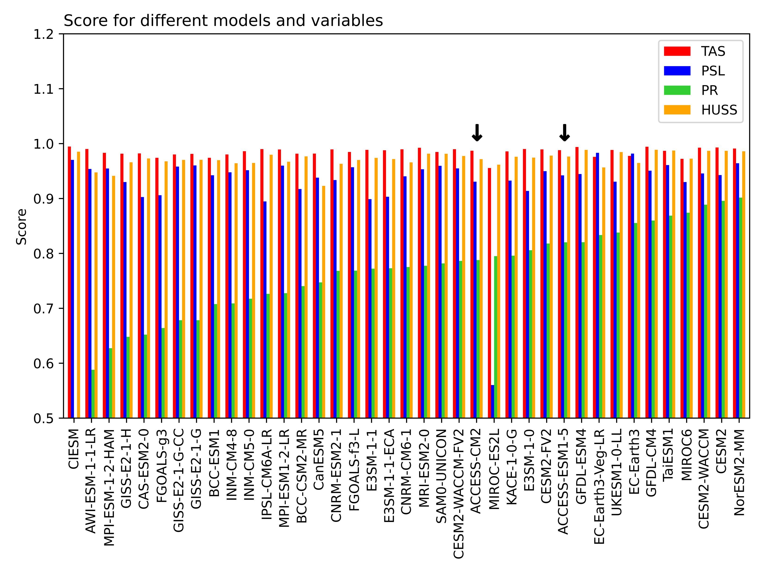
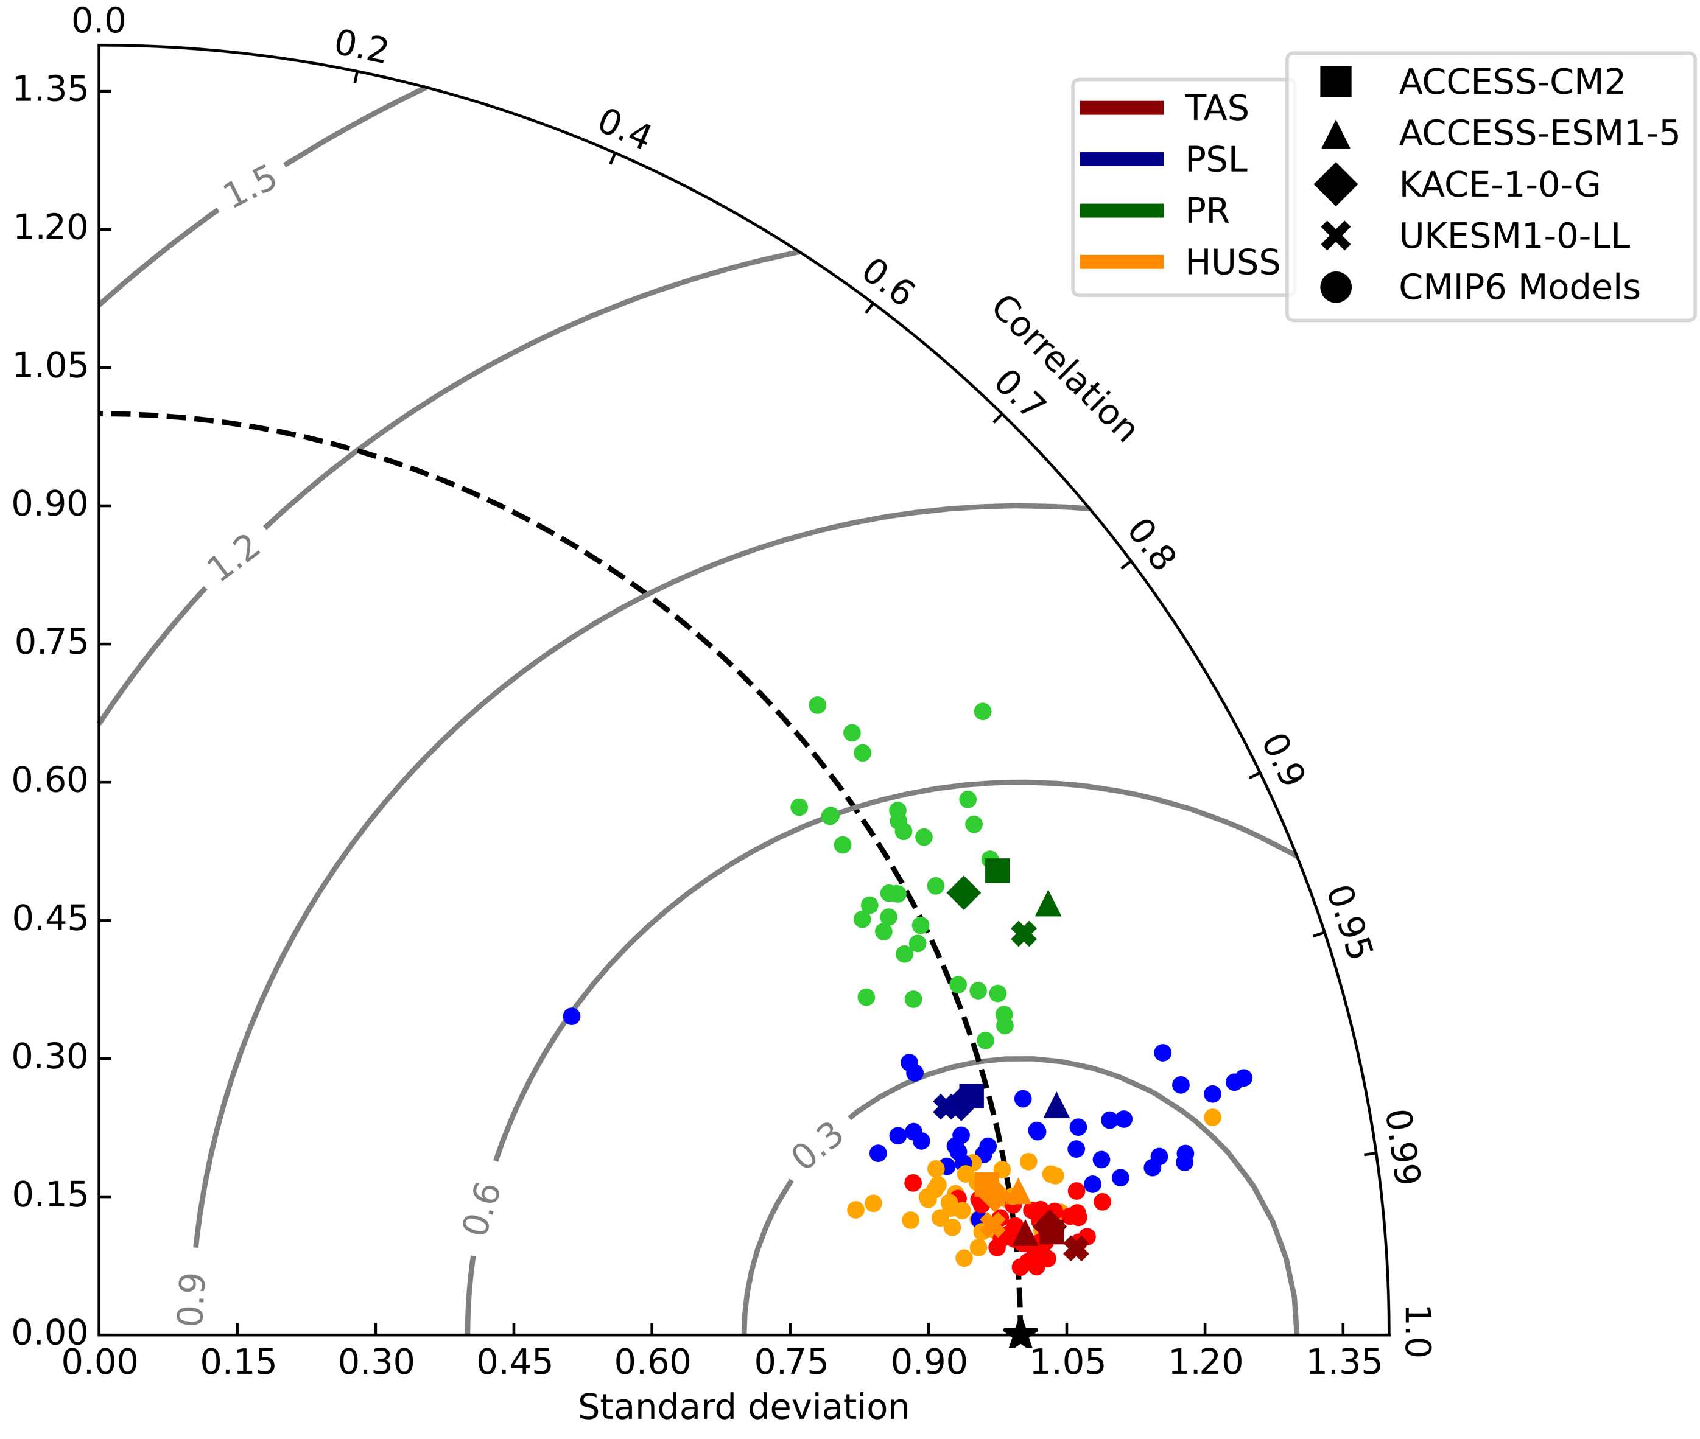
ACCESS vs other CMIP6 models: Taylor diagram
The two ACCESS models perform reasonably well, with ACCESS-ESM1.5 being marginally better.

Slide 4
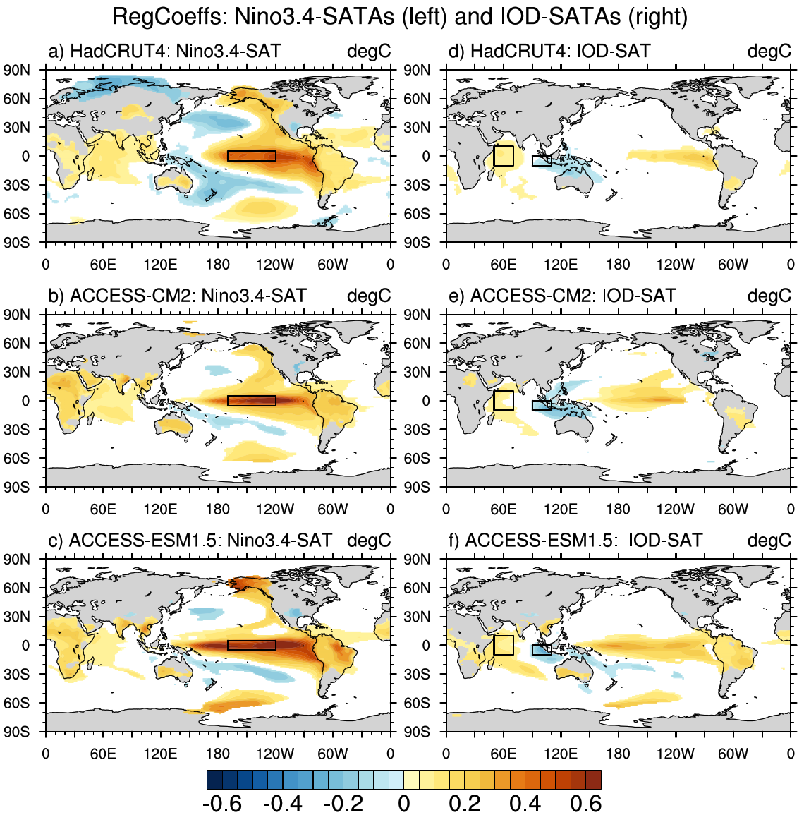
Climate variability: ENSO and IOD modes
The models do well in simulating the large-scale features of ENSO
Both models have a narrower meridional structure
ACCESS-ESM1.5 shows double-peaked ENSO events
Only SAT anomalies statistically significant at the 95% level are plotted
The simulated IOD amplitudes are larger than the observed amplitude
Stronger ENSO-IOD teleconnections in simulations than in observation
ENSO
IOD

Slide 5
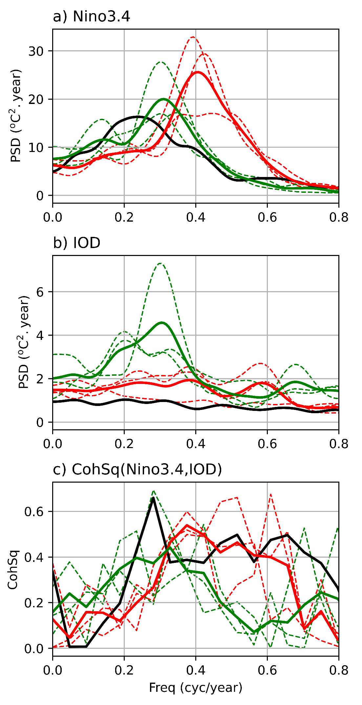
Modes of climate variability: Power and coherence spectra
Nino3.4 index:
Observed spectral peak around 4 years
CM2 spectral peak around 2.5 years
EMS1.5 spectral peak around 3 years
IOD:
No discernible spectral peak in obs and CM2
ESM spectral peak around 3 years (strong in one member)
ENSO-IOD coherence:
Strong ENSO-IOD coupling around the respective ENSO frequencies
Thick solid curves-> ensemble means (for models)
Thin dashed curves-> ensemble members
Notes:
HadSST->HadISST

Slide 6
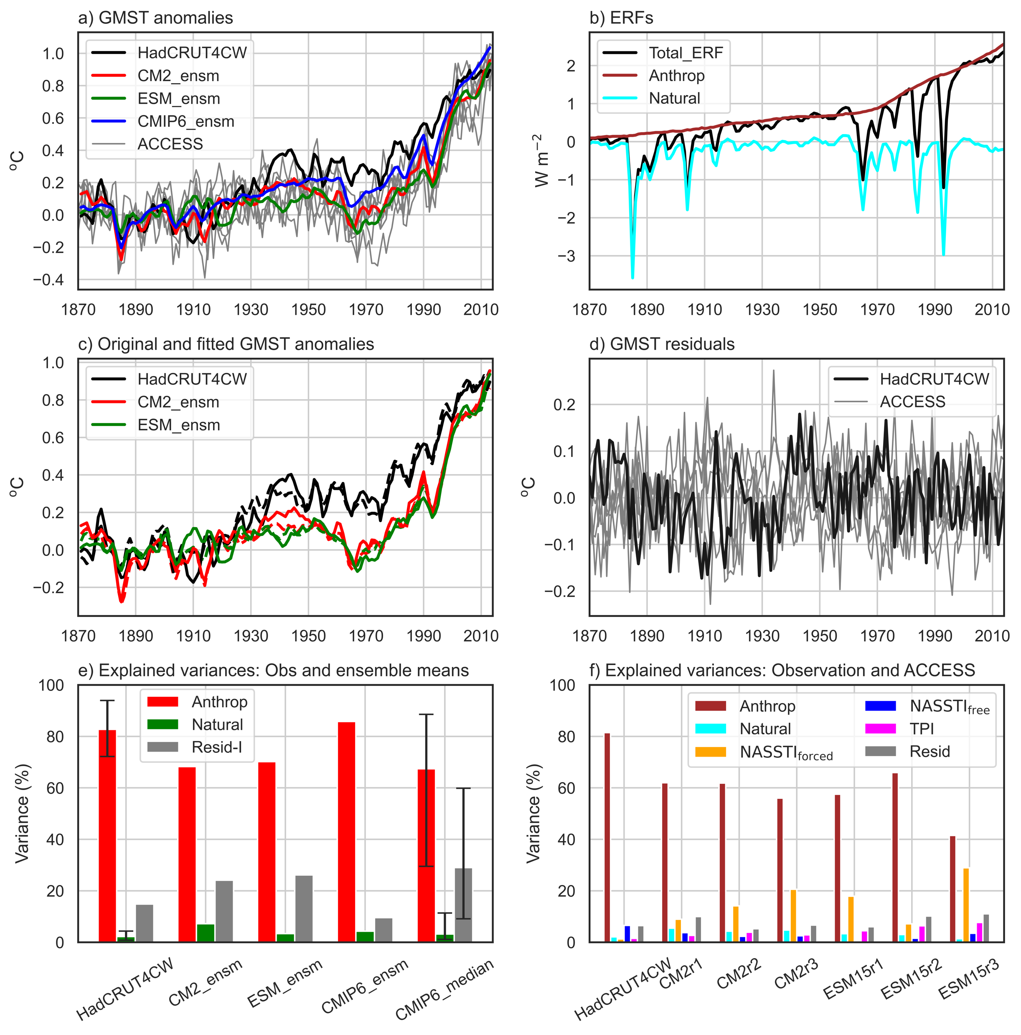
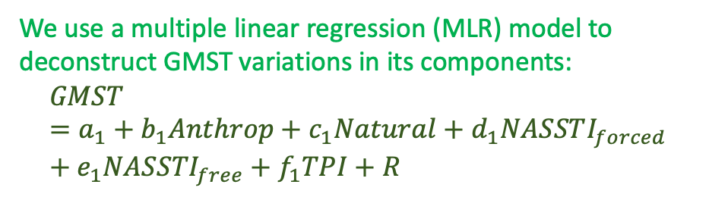
Climate change (1870-2014)
We use a multiple linear regression (MLR) model to deconstruct GMST variations in its components:
$$GMST=a_{1}+b_{1}Anthrop+c_{1}Natural+d_{1}NASSTI_{forced}+e_{1}{NASSTI}_{free}+f_{1}TPI+R$$
Contributions to GMST variations from different predictors are presented as “explained” variances (%) (Figs. e,f)
Anthropogenic forcing is by far the largest contributor to observed (> 80%) and simulated (40-60%) GMST variability
The models’ contributions as a whole are smaller than the observed
NASSTI_{forced} (NASSTI_{free}) is the second largest contributor in ACCESS (observation) (Fig. f)

Slide 7
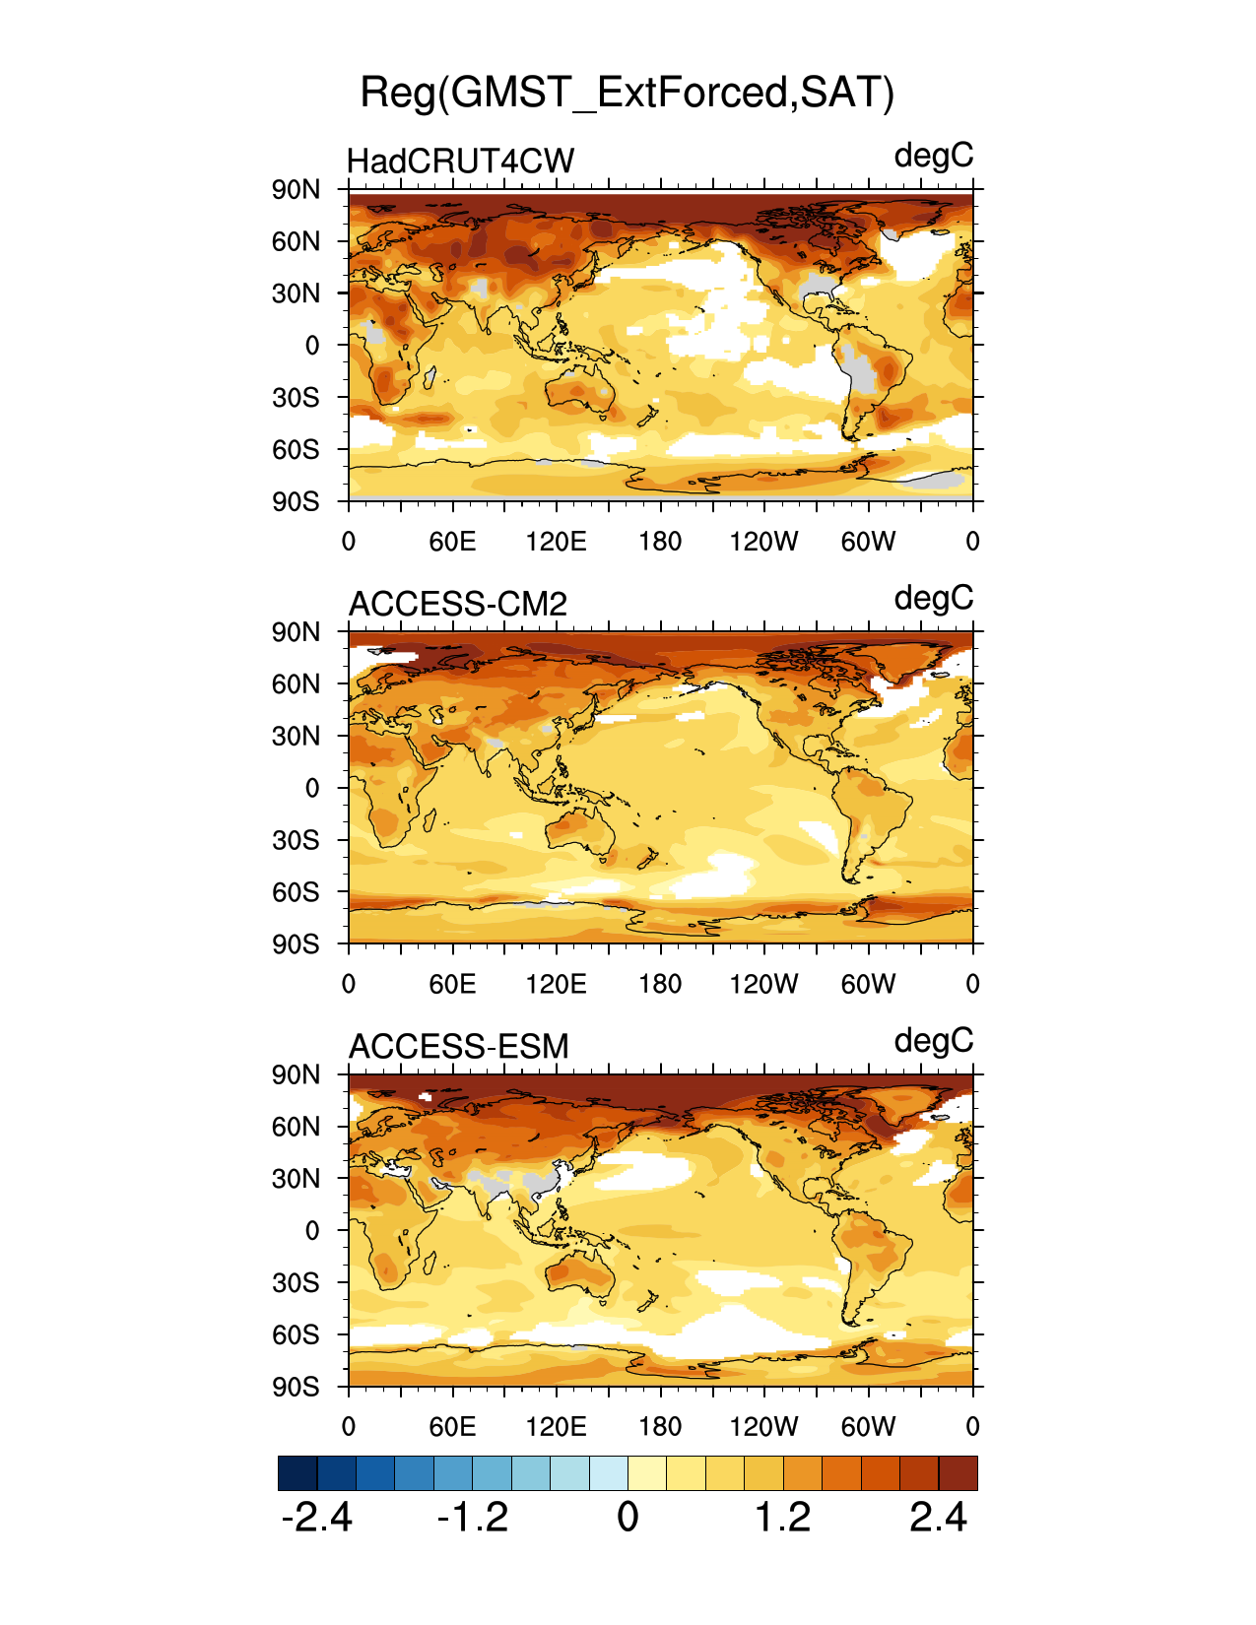
Climate change (1870-2014): Spatial structure (regression)
Spatial structures of externally forced SAT (due to GHGs+tropospheric aerosols+Natural)
Only SAT anomalies statistically significant at the 99% level are plotted
* Ensemble means for ACCESS

Slide 8
Conclusions
Mean spatial structure:
The two ACCESS models perform reasonably well, better than most CMIP6 models for Pr
Climate variability:
The large-scale structures of the interannual and interdecadal modes are simulated well, although the simulated spectral peaks are unrealistic in some cases
Historical climate change:
Significant anthropogenically forced historical climate change (largest around the North Pole)
North Atlantic internal variability is the largest ICV contributor to the observed GMST variability
Pacific internal variability is the largest ICV contributor to the GMST variability in most models

